Slide 1
International Climate Policy
The problem
The solution
What will it cost?
What to do?
International treaties

Slide 4
International Climate Policy
International climate policy has a long history of good intentions
Climate change has been on the scientific agenda since 1896, but global warming started booming in the early 1980s
Politicians started paying attention in the late 1980s, and climate change was a major topic on the United Nations Conference on Environment and Development, Rio de Janeiro, 1992
There, the UN Framework Convention on Climate Change (UNFCCC) was negotiated

Slide 5
Intl. Climate Policy -2
The FCCC is ratified by almost all countries
The FCCC is a framework convention, that is, it sets the rules for later negotiations but does not establish policy targets itself
Except for two.
First, the FCCC acknowledges the „common but differentiated responsibilities“ of countries, that is, this is global problem that is of OECD making, so the OECD should take the lead in solving it
Second, concentrations should be stabilized ...

Slide 6
Intl. Climate Policy -3
The ultimate objective of [the United Nations Framework Convention on Climate Change] [...] is to achieve [...] stabilization of greenhouse gas concentrations in the atmosphere at a level that would prevent dangerous anthropogenic interference with the climate system. Such a level should be achieved within a time-frame sufficient to allow ecosystems to adapt naturally, to ensure that food production is not threatened and to enable economic development to proceed in a sustainable manner.

Slide 7
Intl. Climate Policy -4
The FCCC started a series of negotiations
In 1995, in Berlin, there was almost an agreement
In 1997, in Kyoto, there was one
The Kyoto Protocol specifies
Emission reduction targets
International policy instruments
Unfortunately, the Kyoto Protocol does not specify
How to define and measure emissions
To what extent instruments may be used
What happens if targets are violated

Slide 8
Intl. Climate Policy -5
In The Hague, there could have been an agreement, but the Europeans were to busy fighting each other
From then, the EU would go in with a rigid agreement amongst themselves
In Bonn, Clinton had given way to Bush
Then, Bush pulled out but the US Senate (who control US foreign policy) had already rejected Kyoto
Note that the Senate softened its tone in 2005

Slide 9
Intl. Climate Policy -5
Finally, in Marrakech agreement was reached on measurement of sinks (generous), on instruments (generous) and on enforcement (none), while targets were relaxed
There have been more conferences, which were about fine-tuning
The EU offered greater bribes to Russia, and the Kyoto Protocol entered into force in February 2005
Since then, Canada pulled out and Australia joined

Slide 10
Intl. Climate Policy -6
The Kyoto targets are for 2008-12, but the Kyoto Protocol does not expire
A new protocol is being negotiated
Hard because EU is inflexible and confused, US is not quite ready, and China and India have more urgent problems
Unclear what will happen next
Expectations were high in Copenhagen, and the backlash furious
In Cancun, Durban and Doha, countries agreed to keep talking

Slide 12
Acid Rain Policy
First, there was an agreement between a number of western European countries to cut emissions by 30%
Second, there was a deal between all European countries to bring deposition to its critical load, and to close 60% of the gap by 2010; country targets were differentiated, and the East got help
Third, people started paying attention to the costs and the distribution of the costs of all this

Slide 13
Acid Rain Policy -2
In Europe, acid deposition is falling
Why? It is a prisoner‘s dilemma!
Vehicles also contributed to urban air pollution
Power plants typically operated by semi-governments
There was strong public demand, and a not excessively expensive technical fix
Coal, the dirtiest fuel, was becoming less and less competitive
Eastern European industry collapsed

Slide 14
Ozone Policy
Vienna, 1985: Threat recognised; agreement on information sharing and scientific cooperation
Montreal, 1988: 24 mainly OECD countries agree to phase out production and consumption of CFCs; 5 amendments
London, 1990: 59 nations agree to accelerate and extend the Montreal Protocol; financial support to developing countries
Later amendments refined and extended
Jan 2001: Consumption and production of CFCs is forbidden in the OECD and in most developing countries

Slide 15
Ozone Policy -2
Why this success? After all, the ozone hole is a stronger externality than acid rain, and a global deal was reached
Strong public demand
Availability of a cheap, technological fix (DuPont brokered the deal at Montreal)
Developing countries bribed with money, technology, WTO access
Illegal trade and waste remains a problem
Barrett argues that trade sanctions played a crucial role

Slide 16
Ozone Policy -3
Free-riding brings a reduction in costs that exceeds the increase in damages; thus cooperation breaks down
What can be done about this?
The Montreal Protecol uses trade sanctions to deter free-riding
Indeed, trade sanctions are the only enforcement mechanism in the Montreal Protocol
Sanctions do not apply to all goods, but only to international trade in ozone-depleting substances
That is, countries that do not cut their CFCs, cannot buy them anymore

Slide 17
Montreal Protocol
Art 4.1 „each Party shall ban the import of the controlled substance [...] from any State not party to this Protocol“
Art 4.2 „each Party shall ban the export of the controlled substance [...] from any State not party to this Protocol“
Art 4.4 „... the Parties shall determine the feasibility of banning or restricting [...] the import of products produced with, but not containing, controlled substances“

Slide 18
Montreal Protocol -2
Art 4.6 „Each Party shall refrain from providing [any support] for the export to States not part of this Protocol of products, equipment [etc.] that would facilitate the production of controlled substances“
Art 4A „where, after the phase-out date [...], a Party is unable [...] to cease production [...] for domestic consumption [...] it shall ban the export [...] of that substance“

Slide 19
Ozone Policy -4
How does this work?
Essentially, if a player free-rides, her costs increase
This works if A is greater than the gains of free-riding
How does this relate to the Montreal Protocol?

Slide 20
Ozone Policy -5
CFCs are not difficult to make, but it is much cheaper if you produce them in large volumes
So, for countries without a domestic supply of CFCs, the choice is between having a restricted supply of CFCs for a low price/unlimited supply of HFCs for a medium price, or an unlimited supply of CFCs at a high price
This induced a lot of small countries to sign-up
China and India got goodies

Slide 21
Ozone Policy -6
The story is different for CFC producing countries
In this case, trade sanctions would prevent them from exporting their CFCs
The trade-off is between a restricted supply to the international market and an unrestricted supply to the domestic market
For small exporting countries, the choice is clear
But what about big exporters?

Slide 22
Ozone Policy -7
For big exporting countries, notably the USA, three factors need to be kept in mind
First, for a big country, the difference between cooperative and non-cooperative is relatively small
Second, the hole in the ozone layer is a luxury environmental problem
People in Africa are happy to die of cancer – it means nothing else got them first
Worrying about stuff like marine plankton is an occupation of the rich

Slide 23
Ozone Policy-8
For big exporting countries three factors need to be kept in mind
Third, exporters of CFCs also happen to be exporters of its substitutes; it so happened that US companies dominated the market for HFCs for a while
So, for the sole exporter of the substitute, the choice is between an unrestricted low-value market, and a restricted low-value market plus a high-value growth market

Slide 24
Climate policy
Greenhouse gas emission reduction is a global good: The costs are private, the benefits are shared by everyone.
A rational, selfish actor would therefore reduce emissions by only a little, free-riding on other agents’ efforts
There is no solution to this, apart from installing a world government

Slide 25
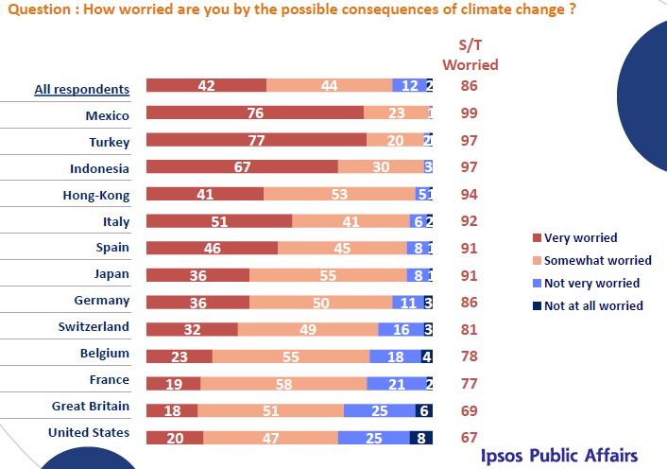
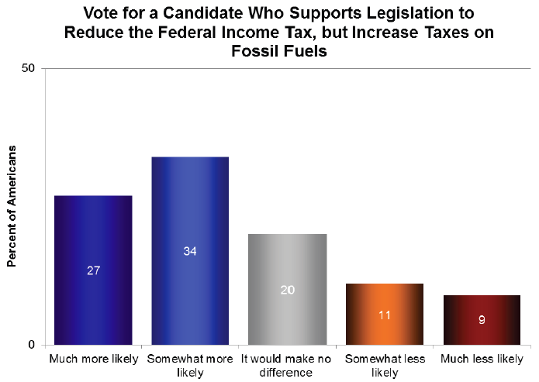
A way forward
Climate policy must be rooted in a domestic demand for emission reduction

Slide 26
Willingness to pay
57% of Australians is prepared to pay a carbon tax of $79/tC on transport fuels
The average European is prepared to pay a $37/tC carbon tax on transport
The average Harvard student is willing to pay $332/tC
The median Harvard student $210/tC

Slide 27
A way forward -2
Unilateral climate policy is expensive, because domestic producers are put at a disadvantage
The UNFCCC establishes standards for emissions monitoring, and its annual meetings are suited for pledge and review
Trade organizations should play a greater role in international climate policy

Slide 28
A way forward -3
The costs of emission reduction vary widely between companies, between sectors, and between countries
The Kyoto Protocol establishes flexibility mechanisms, through which countries can invest in emission reduction elsewhere should that be cheaper than domestic emission reduction

Slide 30
A way forward -4
There is a revolution in energy
Climate policy should stop trying to create its own revolution, and ride the wave of the ongoing revolution instead
The market says shale gas. European politicians say wind, solar, nuclear. Austerity is putting an end to renewable subsidies. American shale is pushing down coal prices. The result is an increase in coal use in Europe, and higher emissions.

